Slide 1


ISO/IEC 27001:2022 – Information Security Management Standard

Slide 2

CONTENTS
1. Awareness Presentation for Implementers
2. Why Information Security Matters
3. What is ISO/IEC 27001:2022
4. Core Principles of ISO 27001
5. The PDCA Cycle (Continuous Improvement Model)
6. Clauses of ISO 27001 (Clauses 4 – 10)
7. Annex A Control Structure (93 Controls)
8. Key Implementation Steps
9. Benefits of Implementing ISO 27001
10. Roles and Responsibilities
11. Common Challenges & Solutions
12. Real-World Examples
13. Measuring Performance (KPIs)
14. Conclusion

Slide 3
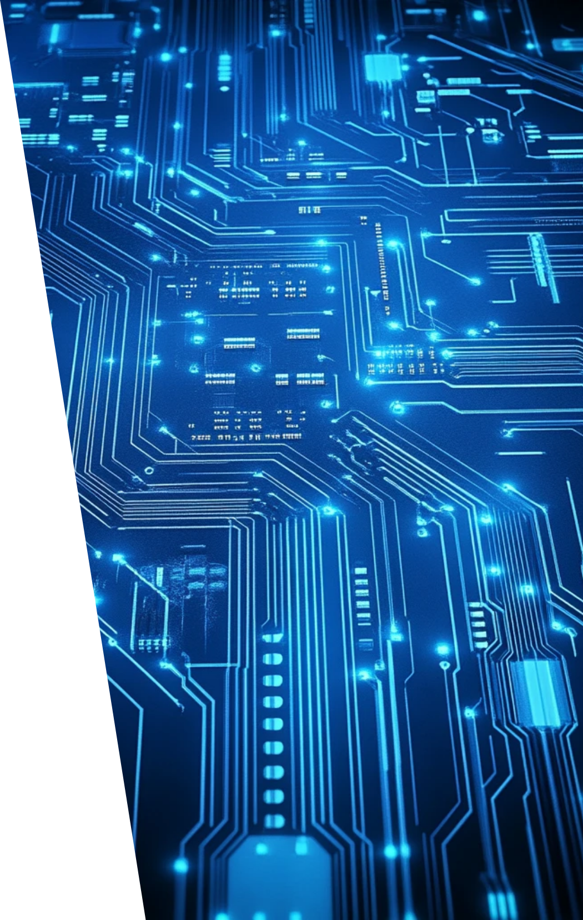
1. Awareness Presentation for Implementers
T. H. Ranasinghe
IT23269484
SLIIT Kandy UNI

Slide 4





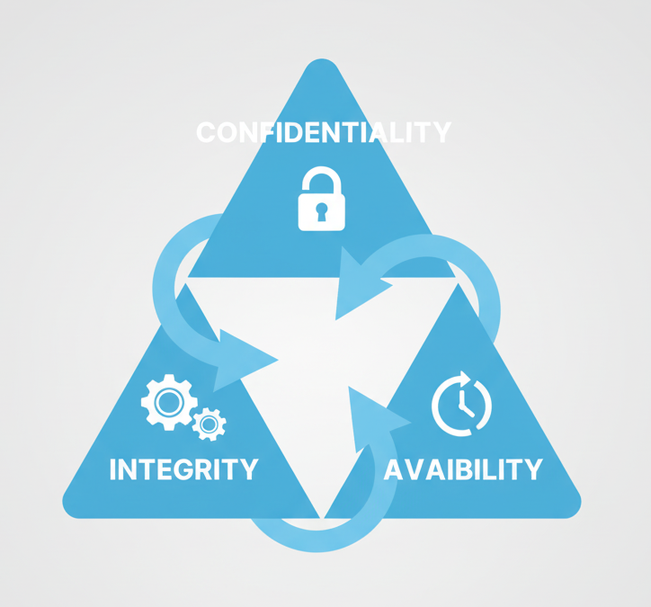

Why Information Security Matters
1
2
Cyber-attacks and data breaches rise > 15% yearly.
Average cost of a data breach ≈ USD 4.45 million
(IBM 2024).
3
4
Threats → malware, phishing, ransomware,
insider misuse.
Information = core asset of every organization.
5
Need structured framework to protect Confidentiality, Integrity, Availability (CIA).
6
ISO 27001 provides this framework.

Slide 5

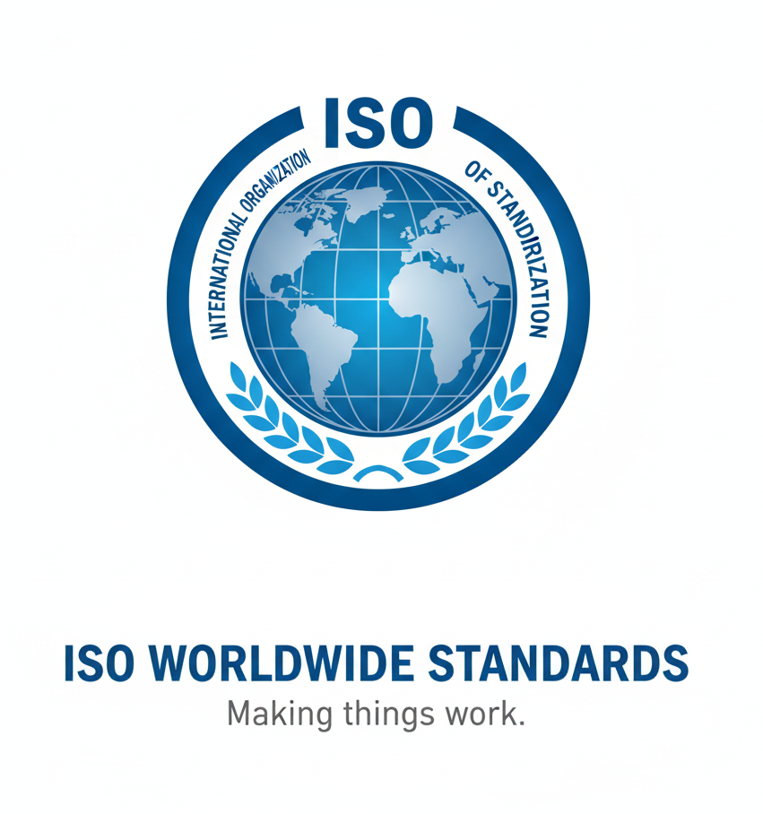
3. What is ISO/IEC 27001:2022
An internationally recognized standard for Information Security Management Systems (ISMS).
It provides requirements to establish, implement, maintain & continually improve ISMS.
It supports risk-based decision making and compliance with laws & regulations.
It applies to organizations of any size or sector and works together with ISO 27002, 27005, 22301, etc.

Slide 6
4. Core Principles of ISO 27001
Principle | Description
Confidentiality | Only authorized persons can access information.
Integrity | Data is accurate and unaltered.
Availability | Authorized users get data when needed.
Risk-based Thinking | Security driven by systematic risk assessment.
Continuous Improvement | Adapt processes to new threats and technology.

Slide 7

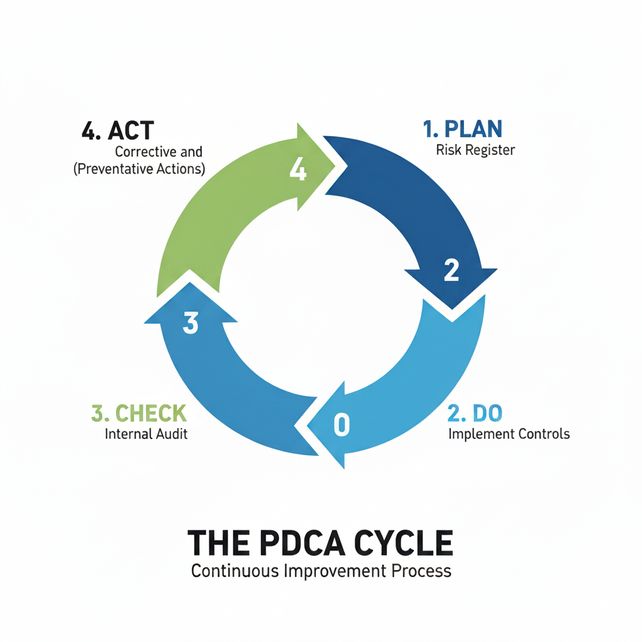

5. The PDCA Cycle (Continuous Improvement Model)
PLAN → DO → CHECK → ACT
Plan
Do
Define context, scope, risk criteria, objectives.
Implement controls, training, procedures.
Check
Act
Audit & measure performance (KPIs).
Apply corrective actions, update policies.

Slide 8
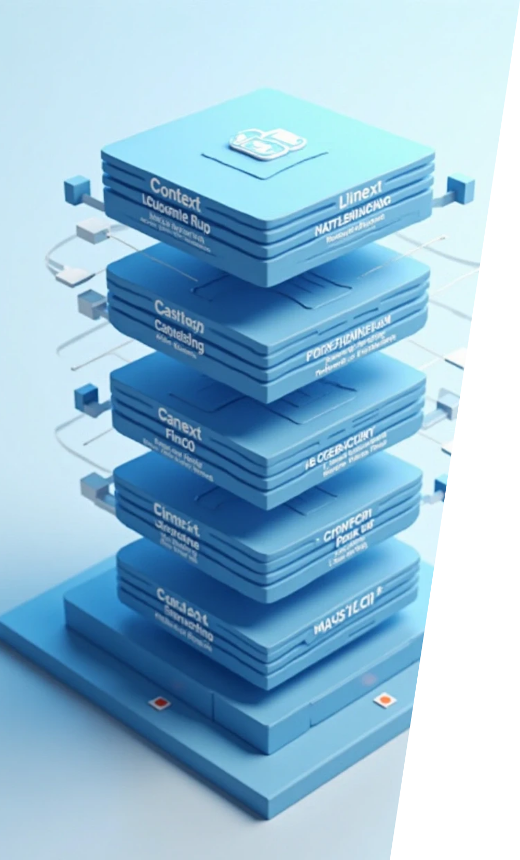







6. Clauses of ISO 27001 (Clauses 4 – 10)
1
2
3
Context of the Organization
Leadership and Commitment
Planning (Risk & Objectives)
4
5
6
Support (Resources, Awareness, Docs)
Operation (Implement Controls)
Performance Evaluation (Audits, KPIs)
7
Improvement (Non-conformity & Corrective Actions)

Slide 9


7. Annex A Control Structure (93 Controls)
4 Domains:
Organizational (37)
People (8)
Policies, Supplier Management, BCP, Compliance.
Background checks, Training, Access Management.
Physical (14)
Technological (34)
Secure Areas, Asset Disposal, Equipment Protection.
Encryption, MFA, Monitoring, Backups.

Slide 10
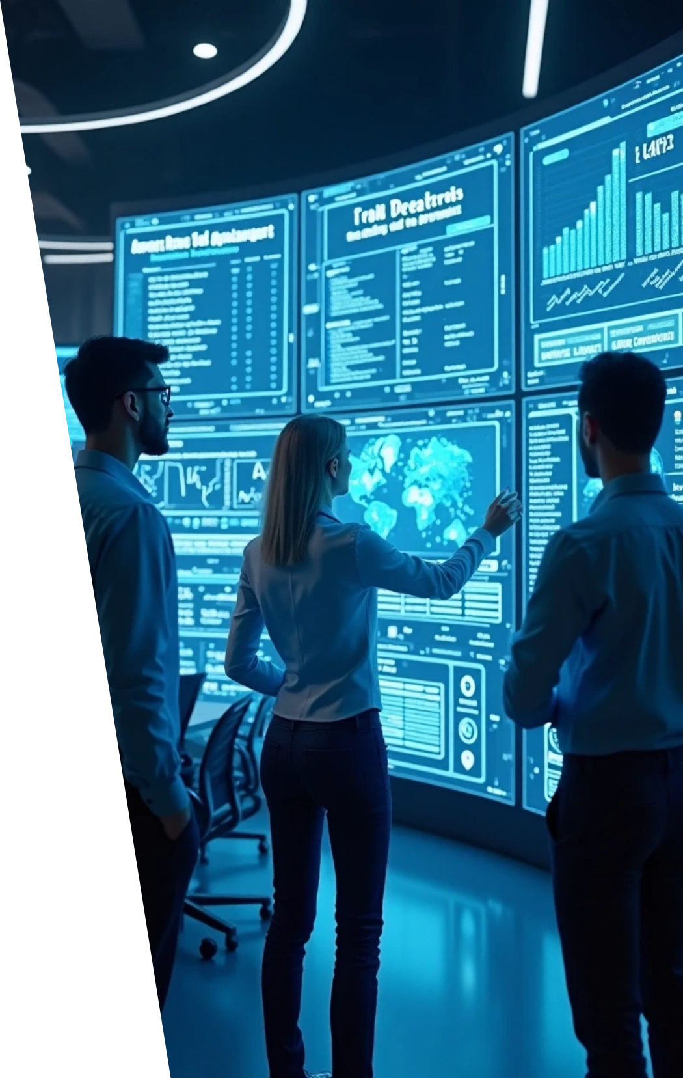


8. Key Implementation Steps
1
Define scope and context of ISMS.
2
Identify assets and risk sources.
3
Create Asset Register, SoA, Risk Treatment Plan.
4
Deploy controls and conduct training.
5
Perform internal audits and management reviews.
6
Implement continual improvement actions.

Slide 11


Benefits of Implementing ISO 27001
Reduces financial loss from security incidents.
Ensures regulatory compliance (GDPR, PDPA, HIPAA).
Builds customer trust and brand reputation.
Improves business continuity and resilience.
Attracts partners through verified security credentials.
Encourages security culture across staff.

Slide 12
Roles and Responsibilities
Role | Responsibility
Top Management | Approve policies, allocate resources, review ISMS.
ISMS Manager | Implement and maintain the system.
Risk Owner | Evaluate and treat risks effectively.
Employees | Follow policies and report incidents.

Slide 13
Common Challenges & Solutions
Challenge | Solution
Lack of Leadership Support | Get executive sponsorship & ROI proof.
Poor Documentation | Use standardized templates and reviews.
Low Awareness | Run monthly training & email campaigns.
Resource Limitations | Implement in phases – focus on critical assets first.

Slide 14






Real-World Examples
1
Hospital X
Implemented ISO 27001 → reduced data breaches by 40%.
2
Bank Y
Used ISO 27001 to align with Central Bank guidelines.
3
Tech Startup Z
Achieved faster client onboarding after certification. (Optional: include one Sri Lankan organization if known)

Slide 15
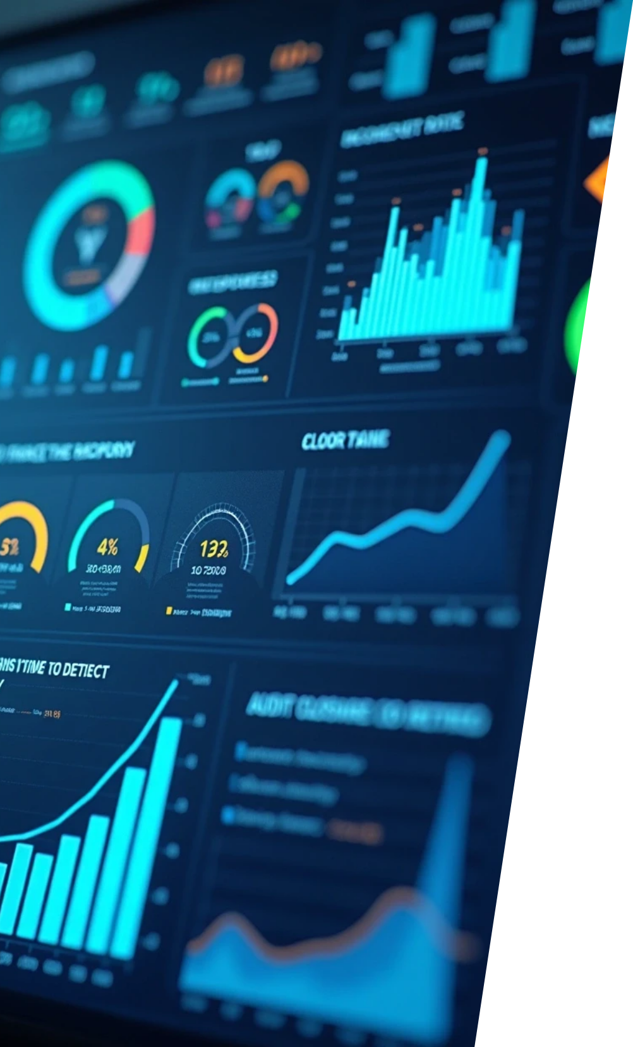


Measuring Performance (KPIs)
Incident Rate ↓ per quarter.
Mean Time to Detect (MTTD) and Respond (MTTR).
% of Employees Trained in InfoSec.
Audit Closure Rate.
Risk Reduction Index.

Slide 16

Conclusion
ISO/IEC 27001:2022 is more than a compliance standard it is a framework for trust, resilience, and continual improvement.
By integrating information security into daily operations, organizations can reduce risks, protect data, and build confidence with customers and partners.
The standard promotes a culture of accountability, awareness, and adaptability against evolving cyber threats.
Through proper implementation, monitoring, and review, the ISMS becomes a strategic asset that strengthens overall business performance.

Slide 17

Thank You

